Slide 1
Data Science Blueprint

Slide 2
Scenario: B2B
Customers
Suppliers
Products
Order

Slide 3







Why Big Data & Data Science Became Important
Traditional analysis methods focused on pre-defined and modelled data, focused on a linear customer engagement model
The Customer Relationship is no longer Linear, It’s Hyper-Connected – Digital World, Data Driven, Agile and Continual Engagement – Context Driven
Business decisions driven by an incomplete view of our environment and customers
Unable to leverage emerging sources (E.g. social) or existing sources - timely
Agility impacted as analysis is historical, unable to analyse immediately, react quickly

Slide 4
Traditional Approach
Apply schema on write
Pull data into query engine
SQL, Relational, Oracle & MSSQL based
Determine
Questions
Design
Solution
Collect
Structured
Data
Ask
Questions
Detect
Additional
Questions

Slide 5
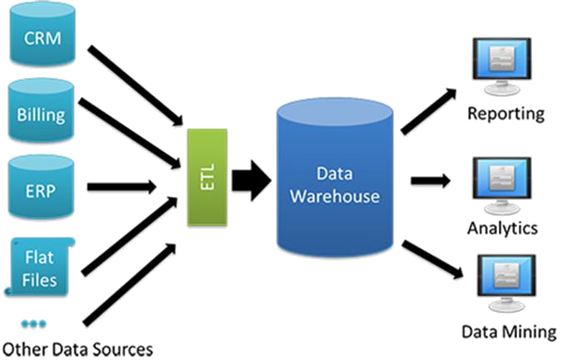
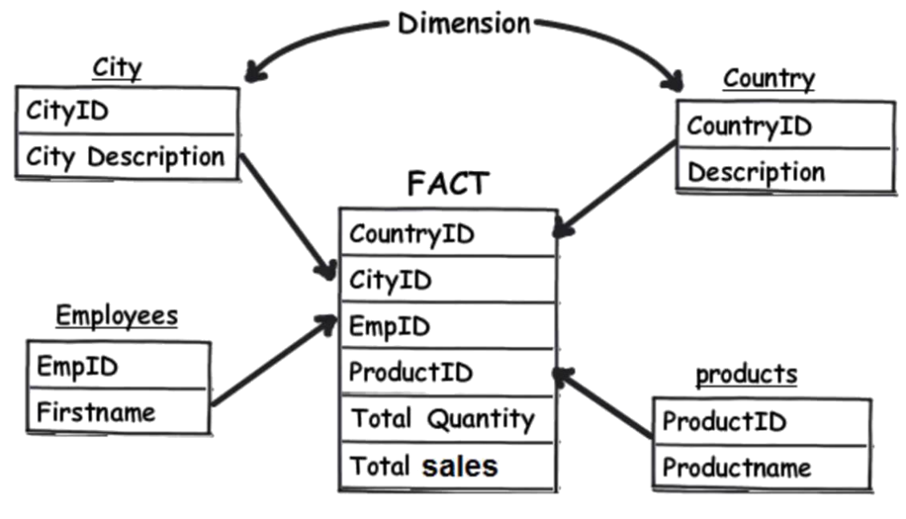
Data Analysis Before Digital Transformation

Slide 6
Changing Shape of Data, Impact …
Forges better relationships with customers
Drives better insight for decision making
Increasing data volume make it difficult to meet regulatory obligations
It is difficult to predict when and where the next data challenge will arise
Data has greatly disrupted their business operations
Source: Experian Global Data Management Report Report 2018 (View Report)

Slide 7
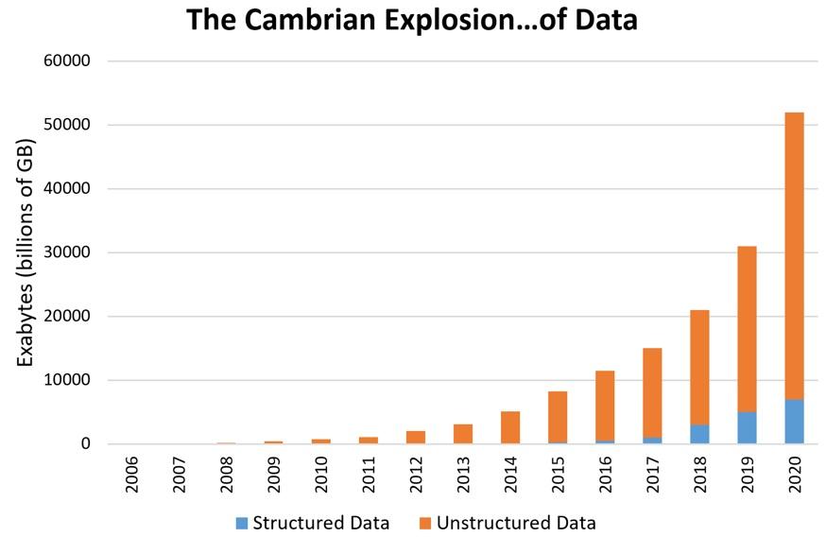
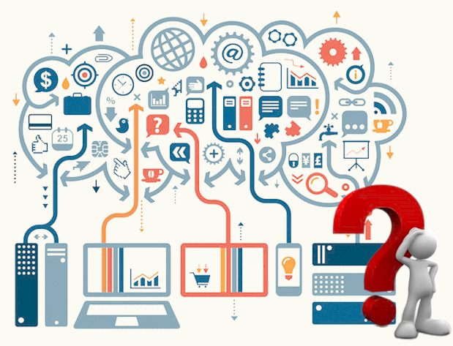
Why Did Data Change?
Sparked by the birth of Web 2.0, circa 2005, Smart Mobile – truly mobile internet
A new approach, leverage all types of data, the complete view
First cited in 1999, Big Data was game-changing, visualise gigabytes of data in real-time
Coined in 2005 by O’Reilly, but the first use of Big Data was much, much earlier, millennia…

Slide 8
And It Got Big
2.5
Quintillion* Bytes of Data Created Daily
1.2
YEARS
Every Minute
The volume of business data doubles every
The average online shopping cart size increases 10-15% as a result of personalised advertising using customer information obtained through Big Data
72 hours of video uploaded to Youtube
4M Google searches
280,000 Tweets
500,000 Tinder swipes
Amazon makes $83k revenue
24,000 Hours of calls on Skype
350,000 photos shared on WhatsApp
90%
900 Exabytes
Walmart
Collects 2.5 Petabytes of data every hour from customer transactions
Of the World’s Data was Created in the Last Two Years
900 Billion GB, the amount of Digital data in existence, 70% created by individuals
* Quintillion is 1 with 18 zeros, a million is 1 with 6 zeros (US scale)

Slide 9







Technology Developed by a Broad Section of Internet Companies
Early Adopters – Searching for a better way to understand their customers, seek opportunity, make decisions

Slide 10
They’re Not Alone …
By 2009 the average US company with 1,000 employees was est. storing over 2,000 TB of Data*
* McKinsey Global Institute (https://www.mckinsey.com/business-functions/digital-mckinsey/our-insights/big-data-the-next-frontier-for-innovation

Slide 11
A New Approach ….
Volume
Variety
Big
Data
Veracity
Velocity

Slide 12





New Benefits…
Can unlock value by making information transparent and usable at a much higher frequency
As companies store more and more data in digital form, they can collect more accurate and detailed performance information on everything*
Allows for greater segmentation of customers to drive more precise and tailored experiences, products and services - Engagement
More sophisticated analytics drives better decision making – Forecasting and Nowcasting
Drive improvements in future product and service development, proactive respond to customer need – Product Usage
* Conduct controlled experiments to make better mgmt. decisions

Slide 13

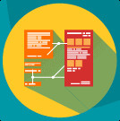

Success From New and Existing Roles
Data Science
Data Analytics
Big Data
Works with complex data and comprises of everything related to cleansing, preparation and analysis
Focused on automating insight into a specific dataset using query and aggregation techniques
Use all data to analyse insights, leading to better decision making and strategic business opportunities
Python coding
Problem solving
Capture data using ingenuous means
Working with unstructured & structured data
Machine learning
Look at things differently
Communication and data visualisation
Business knowledge
Data manipulation
Analytics
Mathematics
Statistics
Computer science
Business skills
Creativity
Skills
Skills
Skills

Slide 14
New Approach Combined With The Old
SQL, Relational, Oracle & MSSQL based
Apply schema on write
Pull data into query engine
Determine
Questions
Design
Solution
Collect
Structured
Data
Ask
Questions
Detect
Additional
Questions
Traditional Approach
Augment with Distributed Tech
Apply schema on read
Send query to data
Multiple query engines
Big Data Approach
Produce & Consume
Interactive
Real-time
In-memory

Slide 15

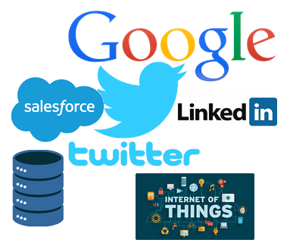







Underpinned by Different Technology & Skills
Sources
Ingestion
Streaming
Processing
Presentation
Skills
Skills
Skills
Skills
Skills
Existing skillsets spanning API’s, SQL, File, Saleforce, Anything
Python
Java
Dataflow design
Data Warehousing
AWS
Apache Kafka
Apache Spark
Scala
Python / R
SQL
Sentry
Apache Spark
Scala
Python / R
Data Warehousing (Snowflake)
AWS
PowerBI
Apache Spark
Application Dev
Campaign Mgmt.
Streamlit
Technology
Technology
Technology
Technology
Technology
Machine
Learning

Slide 16
Opportunities
Engagement Data:
Collating this data longer than the other areas
Includes customer account and contact data, and data about how our customer transacts with us
Includes marketing views of this data including segmentation
GDPR has introduced string guidelines on how this data is stored and used
Meta Data:
As a result of GDPR and other legal requirements this is data about where data is stored and how data is processed and controlled
Data and flows have been mapped and is being transposed into a database
Engagement Data
Data we collect to engage and transact with our customers (leads, billing, service etc.) and to drive our marketing activities
Product Usage Data
Data we collect on how our customers use our software aka telemetry
Meta Data
Data we collect on where our customer data is stored to answer GDPR / compliance data subject requests
Customer’s Own Data
Data we collect for, and data we collect to safeguard, collective intelligence and Machine Learning.
3. Product Usage Data:
Data on how our customers use our products is captured enabling analysis on this data to identify things like churn or use of particular capabilities
This data can be anonymised (for aggregate analysis) or used to engage directly with customers (dependent on consent)
4. Customer’s Own Data:
This is the least understood area in terms of implications (legal and/or ethical) whilst there is significant potential value for Sage and its customers alike
This includes data we collect to safeguard activities to ensure our teams do not ‘cross a line’
1
3
2
4

Slide 17
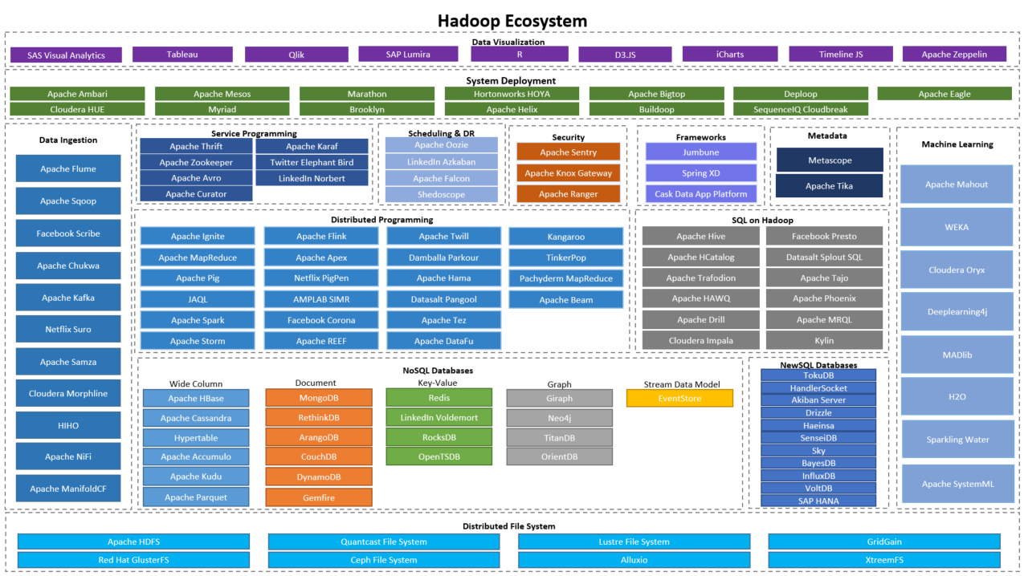
Big Data Underpinned by Open Source

Slide 18



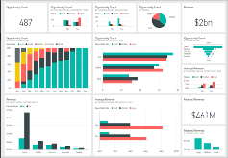
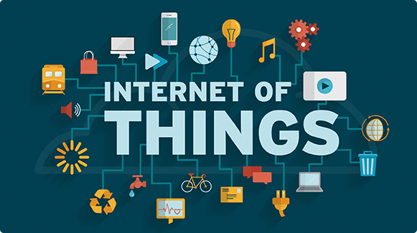



Big Data Architecture
Sources
Ingestion
Streaming
Processing
Presentation
Machine
Learning
Security & Deploy

Slide 19
Appendix

Slide 20

We’re Unstructured!
The Average Adult has a Vocabulary of 20-35,000 Words
The Average Adult Will Learn One New Word a Day Until Middle Age
The Average Native Speaking 4 Year old Will Know 5,000 Words
Native Speaking 8 Year Olds Will Already Known 8,000 Words
Average Foreign Speaker Will Learn 10,000 Words by Living Abroad
The Most Common Vocabulary Size for a Foreign Speaker is 4,500 Words
Foreign Speakers Will Learn 2.5 Words per Day on Average

Slide 21


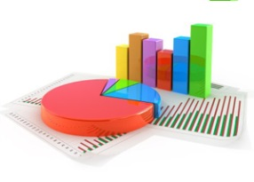





How can Technology Enable Insight
Data Capture
Analyse
Visualise
React
Machine Learning
SQL
Spark
Graph
Map/Reduce
Drive strategy, business change and trigger events, customer and business focused, Personalise the customer experience
Use to drive monetisation of Pay&Go software, as well as Product Development opportunities, etc
Yarn
Hadoop
Consume structured & Unstructured data from Sage and 3rd Parties
Cloud
Analytics Platform

Slide 22
Backup Slides

Slide 23
The Four V’s
Characteristic | Description | Attribute
Volume | Huge quantities or intensity of data Required to be ingested, analysed, and required to make decisions Scalable storage and distributed queries
Velocity | Speed that data is being generated Speed that data is changing Speed that data must be received, understood and processed Stale data provides little business value Need for offline data processing (Machine learning) | Accessibility When, where and how a user wants to receive it Applicable Relevant and valuable Time value Real time analysis Improved data driven decisions
Variety | Adoption of new data/information sources From inside and outside of the company Placing integration, management, governance and architectural pressures on IT | Structured, fixed schemas Unstructured, systematic and human generated (E.g. media, social, mobile, chat, sensors) Semi-structured, drive toward a combination of both
Veracity | The uncertainty of data | Business leader trust in the data they use to make decisions Poor data quality leading to escalating costs Low level of confidence in how many data owned by a company is poor

Slide 24
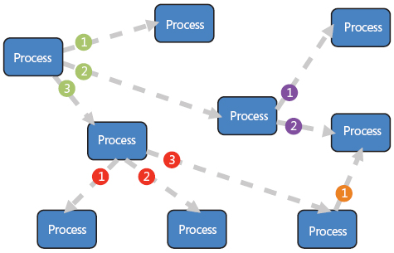
A Central Nervous System
At its highest level, a software component, or event, executes a response to receiving one or more event notifications.
A key feature is that the server component that sends the
notification does not know which component is on
the receiving end
Async Push Based Messaging
Remove Dependency on Downstream Systems to Complete Business Tasks
Autonomous Messages, Just Enough Information
Simplify Deployment of Each Independent System
State-less
Application Flow Ownership shifts to Consumers
Greater Level of De-coupling, Removing Request/Response Overhead
Speed, Near-Real-Time Propagation across Enterprise

Slide 25
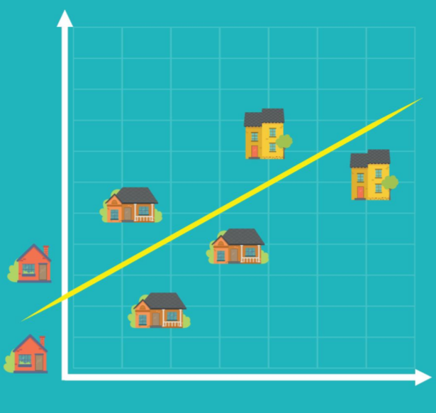
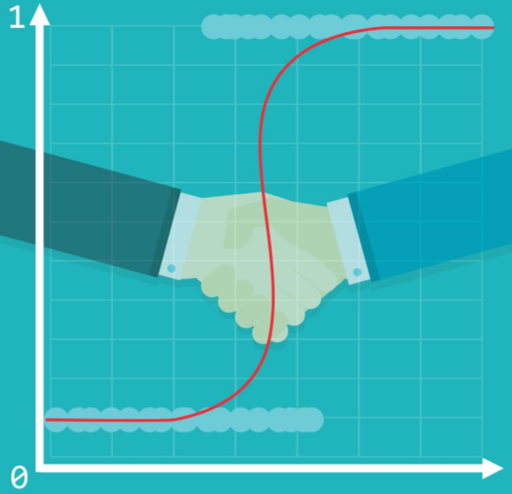
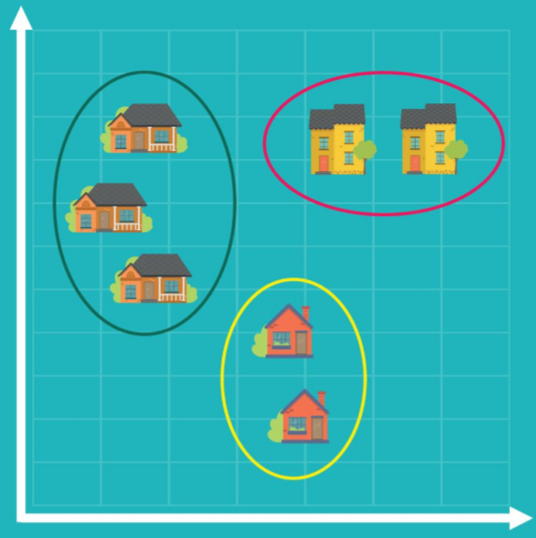
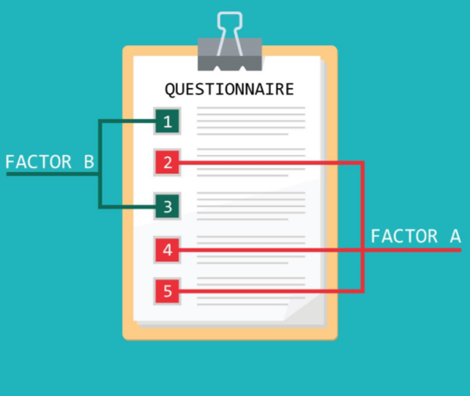
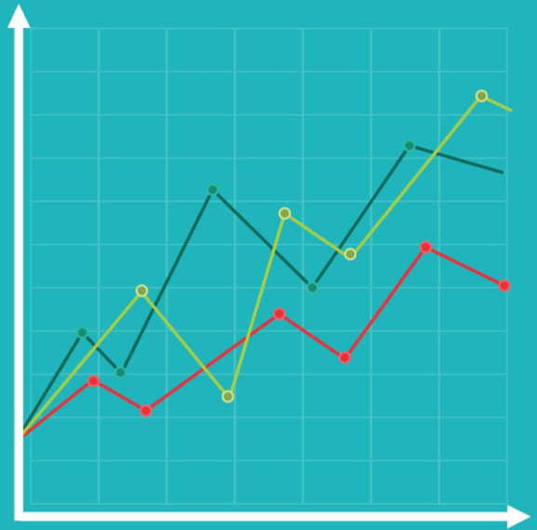
Traditional Approaches Some Overlaps with Machine Learning ….
Linear Regression
Logistic
Regression
Cluster Analysis
Factor Analysis
Time Series Analysis
Identifies the causal relationships amongst different variables
E.g. House price influenced by neighbourhood, house size, age, etc
Overcomes relationships that cannot be described linearly as 0 and 1
I.e. Filtering job candidates and how successful they will be in the first year (E..g > 50% success then 1 otherwise 0)
Exploratory approach where observations in the data form groups according to a categorisation
E.g. House price cost in-relation to size and location to a major centre (Downtown)
Like Cluster Analysis but focused on features rather than observations
E.g. if in a 100-item questionnaire every 10 questions pertains to a single attitude, factor analysis will identify the 10 factors. These can then be used for a regression, to provide a more interpretable prediction
Widely used in finance and economics, used for following values over time.
E.g. Tracking stock price changes over time, where time is presented horizontally

Slide 26
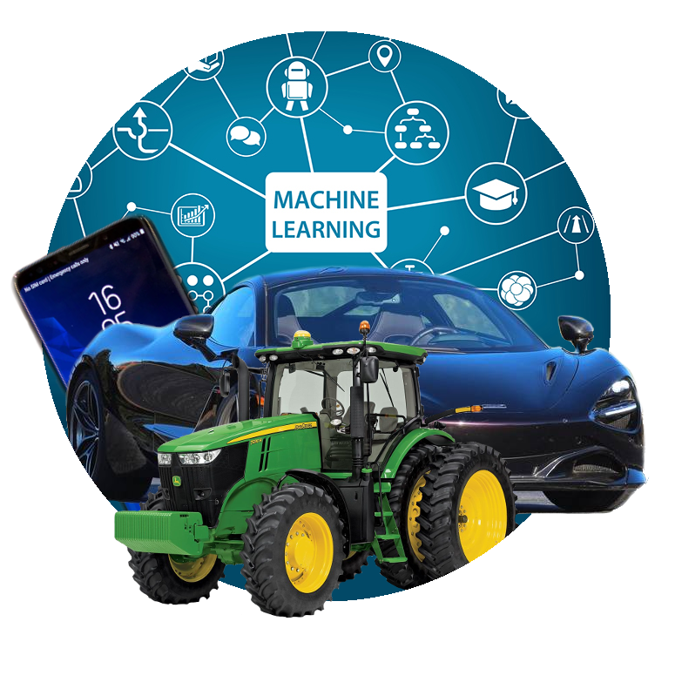
Machine Learning
State of the Art
Approach
The computer uses the algorithm to discover the model that finds what is being sought
An evolution over traditional approaches, as unlike before the Algorithm is at its core.
Human involvement is minimised, and in Deep-Learning the internals are often too complex

Slide 27
How Does It Work?
y = m * x + b
m¹
m & b are the only values available to train/adjust – no other way to affect the line
** There can be many lines **
m²
[
Weights
]
[
Biases
]
m^{1,1}
m^{2,1}
m^{3,1}
,
,
,
m^{1,2}
m^{2,2}
m^{3,2}
b^{1,1}
b^{2,1}
b^{3,1}
,
,
,
b^{1,2}
b^{2,2}
b^{3,2}

Slide 28


The Training Process
1
We use random values for W & B, making sure not to bias one state over another
2
We compare the output with what we expect it to have produced. We update W & B and Test again. As training progresses, M (the line) moves closer to identifying the correct separation between attributes
Training Data “Labelled Data”
[
Weights
]
[
Biases
]
m^{1,1}
m^{2,1}
m^{3,1}
m^{1,2}
m^{2,2}
m^{3,2}
b^{1,1}
b^{2,1}
b^{3,1}
b^{1,2}
b^{2,2}
b^{3,2}
,
,
,
,
,
,
3
Now we use Evaluation to see if the Model is any good. Use data that wasn’t used for training
Model
Prediction

Slide 29
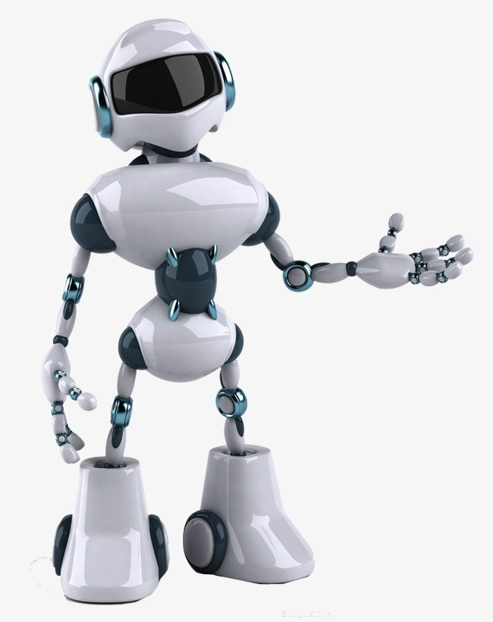

Computers dig Data Structures & Binary Data
00110101000101000101011001010001110101011001110010101110101111

Slide 30




History
Experi-ence
Emotion
Visualise
Real-Life

Slide 31
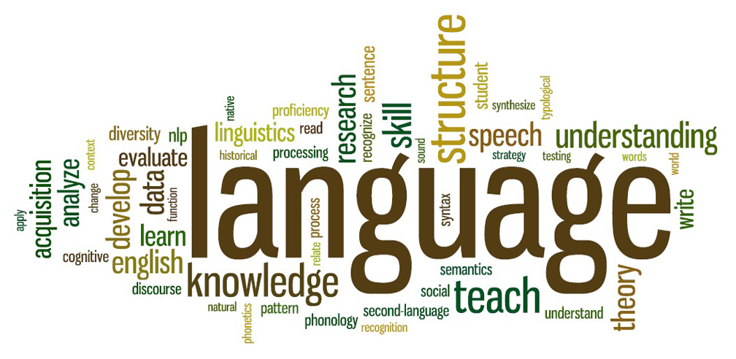

Natural Language Processing (NLP)
Sub-field of Artificial Intelligence
Understand and Process Human Languages and Generate Speech
Enable computers to get close to how Humans use Language
It’s not easy, they do not have Intuition, they cannot understand what the language is trying to say
Deep Learning Advancements – Translation, Summarisation & Semantic Understanding

Slide 32



Why is NLP Hard?
Someone was on fire, did anyone call the Fire Brigade?
My team was on fire last night, they absolutely killed the opposition!
Fire
Killed
People died, surely whatever the problem was, it could be been resolved another way?
Opposition

Slide 33
How does it Work?
Natural Language Processing (NLP)
Natural Language Understanding (NLU)
Natural Language Generation (NLG)
Convert
Decompose
Understanding
Translate
Speech
Speech recognition (Hidden Markov Model)
Statistical models to determine what was said
Compare 10-20ms segments
Called “Part-of-Speech Tagging” (POS)
Understand the meaning of each word, is it a noun, verb, past-tense, etc
Lexicon and grammar rules
Statistical Machine Learning (ML)
Challenges with Polysemy and Synonymy
What information to translate?
Results of a query, organised into a structure of what it wants to say
Reverse of NFU, lexicon and grammar rules to author sentence
The engine can now use the nuances of the audience to communicate back to the human
If vocalised, a text-to-speech engine will take over

Slide 34


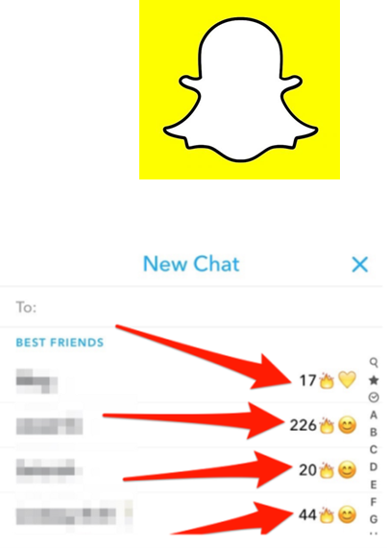

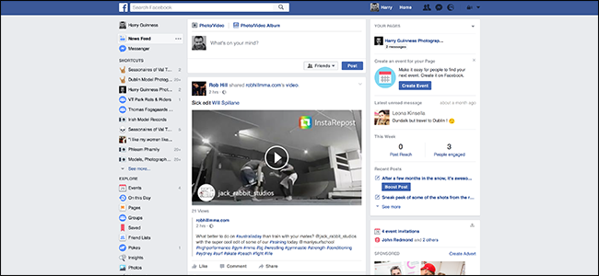
Persuasion in Technology

Slide 35
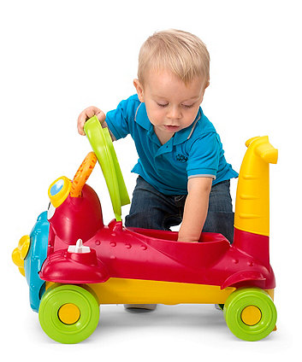
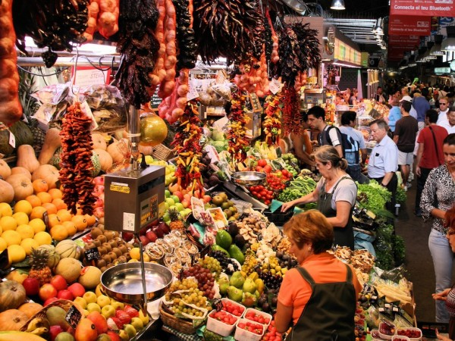

Persuasion isn’t New

Slide 36
WWF – Saatchi & Saatchi

Slide 37








Persuasion in Technology
1996, BJ Fogg postulates the theory of Persuasive Technology
1997, Persuasive Technology formalised at the “Conference on Human Factors in Computing Systems” conference. Renamed “Captology”
1998 – Present, Service providers focus Data Analytics to understand people, behaviours and attitudes
Today, highly personalised services designed to maximise Stickiness, Ad Revenue, new Habits

Slide 38
What is it, Persuasion?
“Goal to change attitude or behaviour in some way”

Slide 39
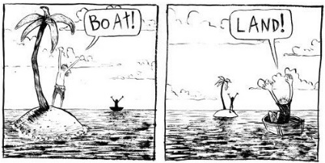




Perspectives
Intentionality
Functional View
Levels of Analysis
Design Space
Ethics
Intentionality
Functional View
Levels of Analysis
Design Space
Ethics
Endogenous
“From Within”, when a creator or design produces technology with the intent to persuade
Exogenous
“Caused by”, when one person shares technology with another with the intent to change attitude or behaviour
Autogenous
“Self-produced”, when a person chooses to adopt technology with the intent to change their own attitude or behaviour
Three actors, Tool, Media and Social
A computer is a tool that gives people power to do something that couldn’t do before, or do something more easily
Technology can present different media from static content through to sensory and augmented reality content
Social describes how people respond to technology, whilst technology itself aligns with human characteristics (voice, emotion), play roles (coach, assist) and follow social rules (greetings, apologies)
Captology
Spans from the individual to societal, shifting perspectives/levels across Individual, Family, Organisational and Community
Persuasion happens at all levels
Levels draw upon different frameworks, measures and methodologies
Approach
Psychological mechanisms designers can employ to bring about attitude, and behavioural change and ultimately drive new habits
How ethical is Persuasive Computing?

Slide 40
Why Data Is Hard To Move …
Standards
Format
“Exactly Once” Delivery
Protocols
Veracity/Conformity of Information
Validity/Quality of Information
Ensuring Security
Overcoming Security
Compliance
Schemas
Consumers Change
Credential Management
“That [person | group | team]”
Network

Slide 41
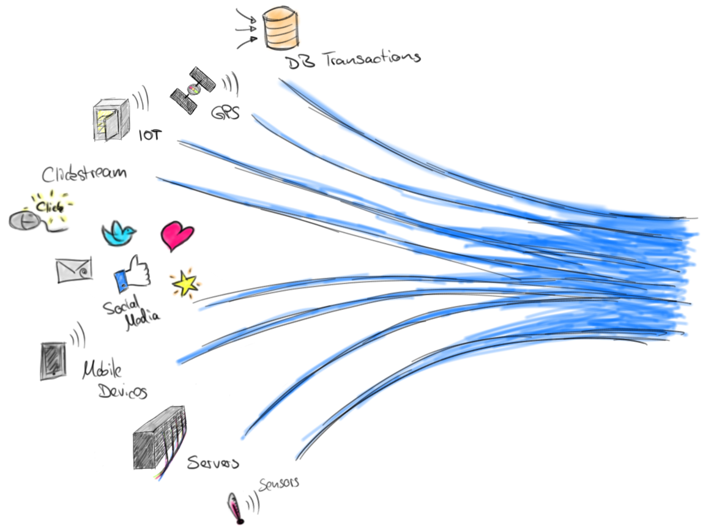
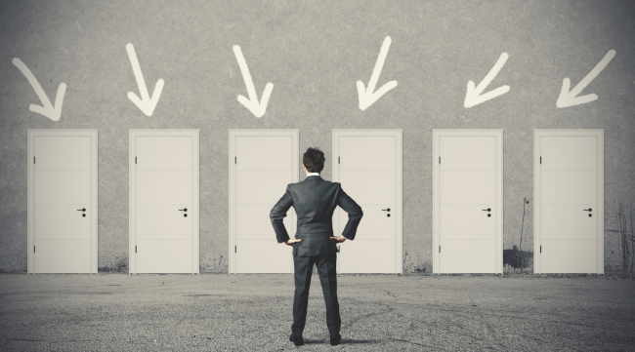
Streaming Makes It Harder …

